Slide 1
Web Workers in JS

Slide 2
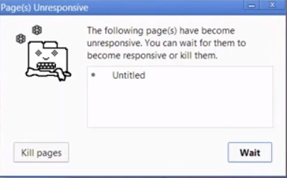
WHY?
JavaScript – Single threaded application
Large and complex task – make page unresponsive

Slide 3
COMMON MISCONCEPTIONS
AJAX runs ASYNC, is it multi-threading?
This is called NON BLOCKING – still single threaded

Slide 4
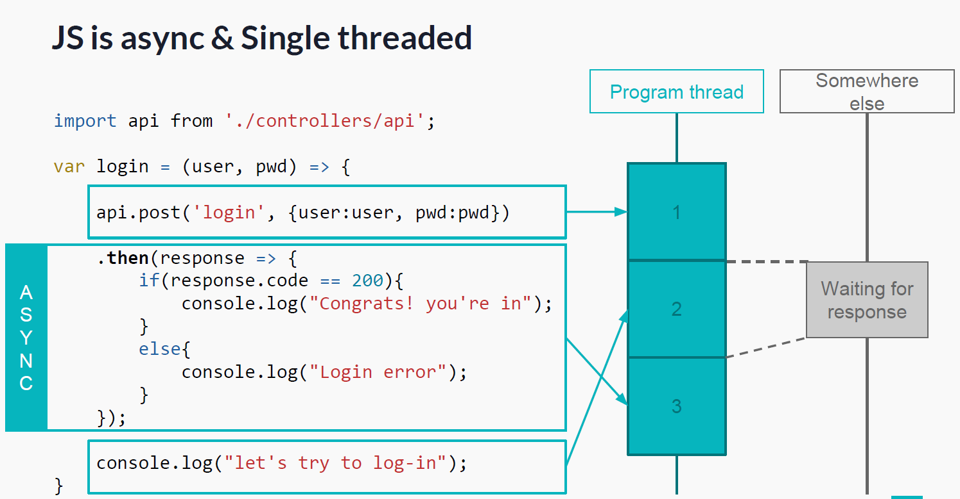

Slide 5
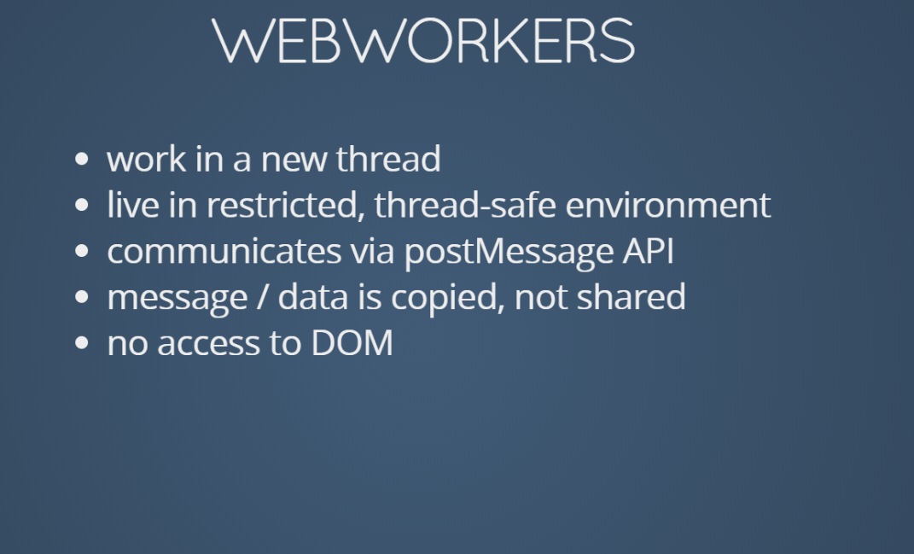

Slide 6
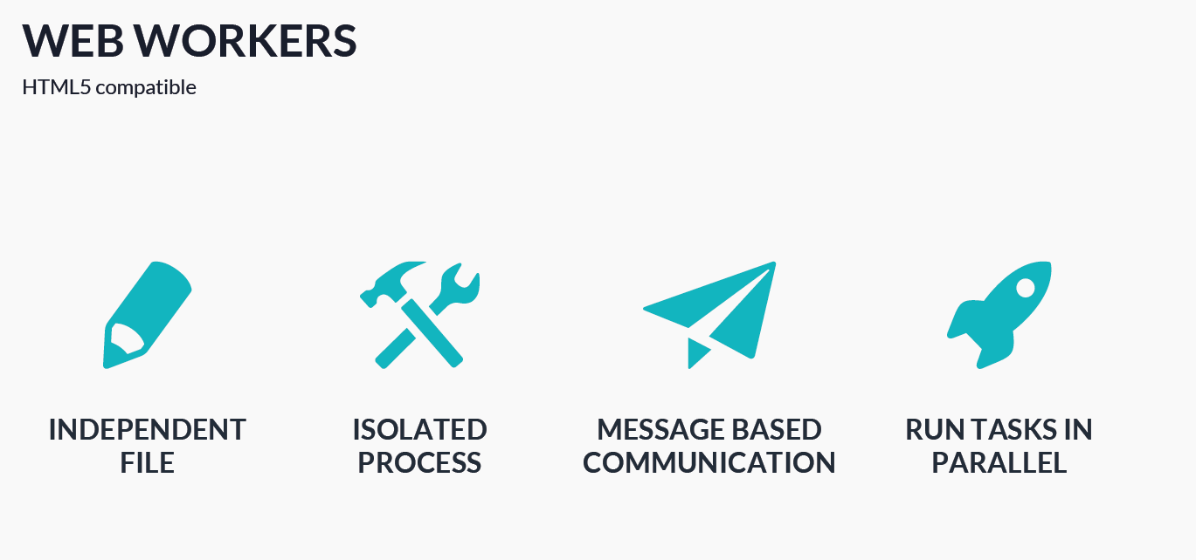

Slide 7
HOW DOES IT WORK?
Web worker- spawn separate script in background – Delegate work to the worker
Communication – using post message
Receive message – on message callback

Slide 8
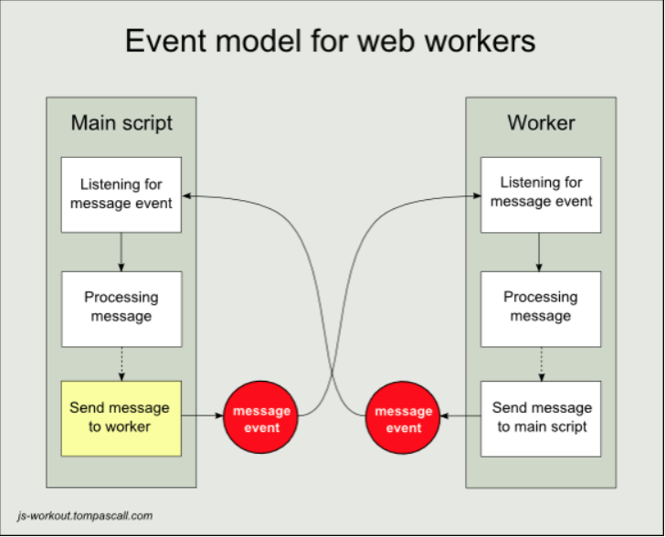

Slide 9
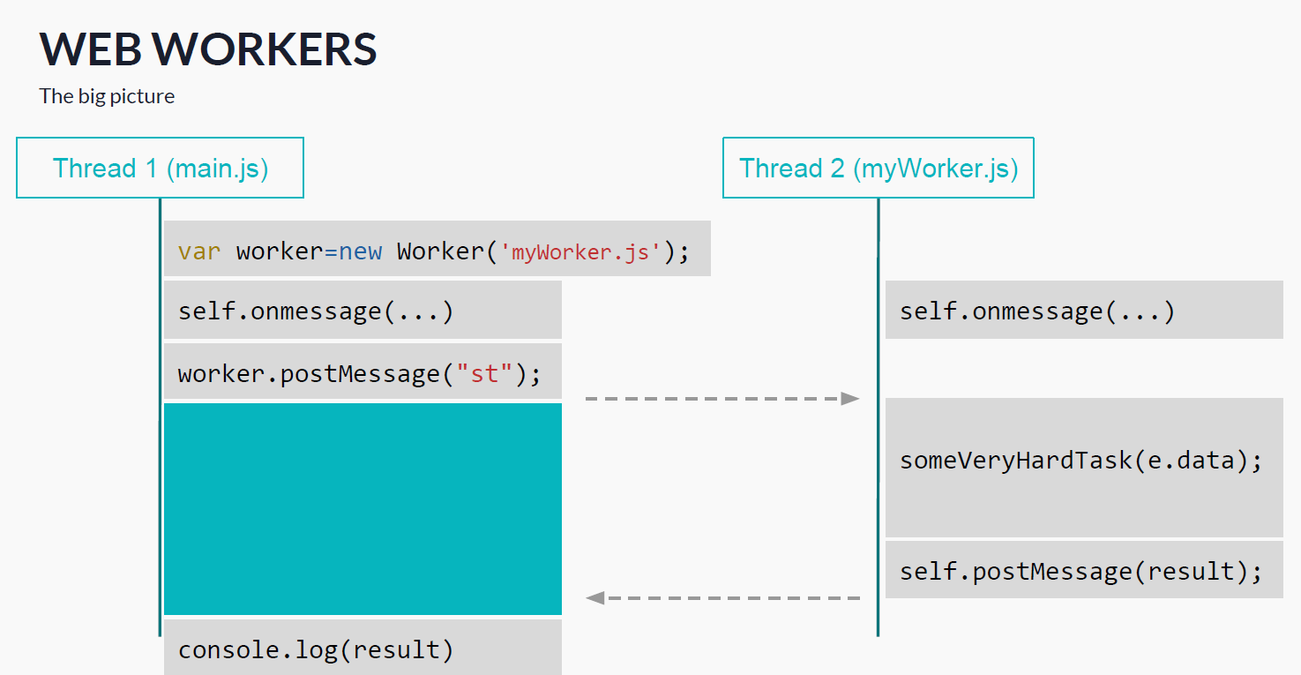

Slide 10
DEMO

Slide 11
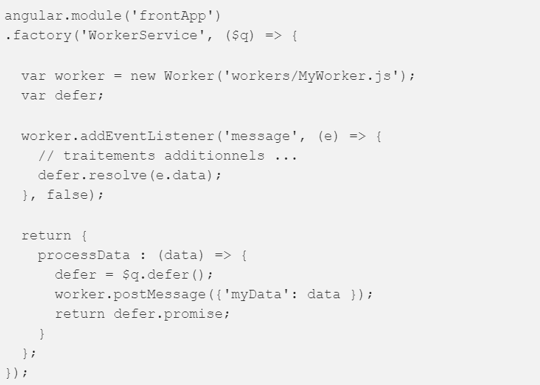
Integration of web workers in AngularJS

Slide 12
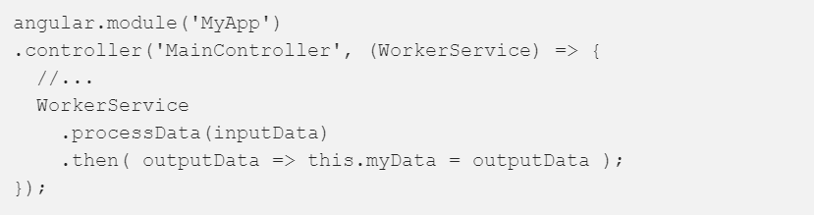
Integration of web workers in AngularJS (II)

Slide 13
Web Worker Applications
Reading/writing local storage databases
Real time text formatting, spell checking, and syntax highlighting
Filtering images in a canvas
Processing large JSON datasets
Processing multimedia (audio and video)
Complicated math formulas, such as finding the largest prime number

Slide 14
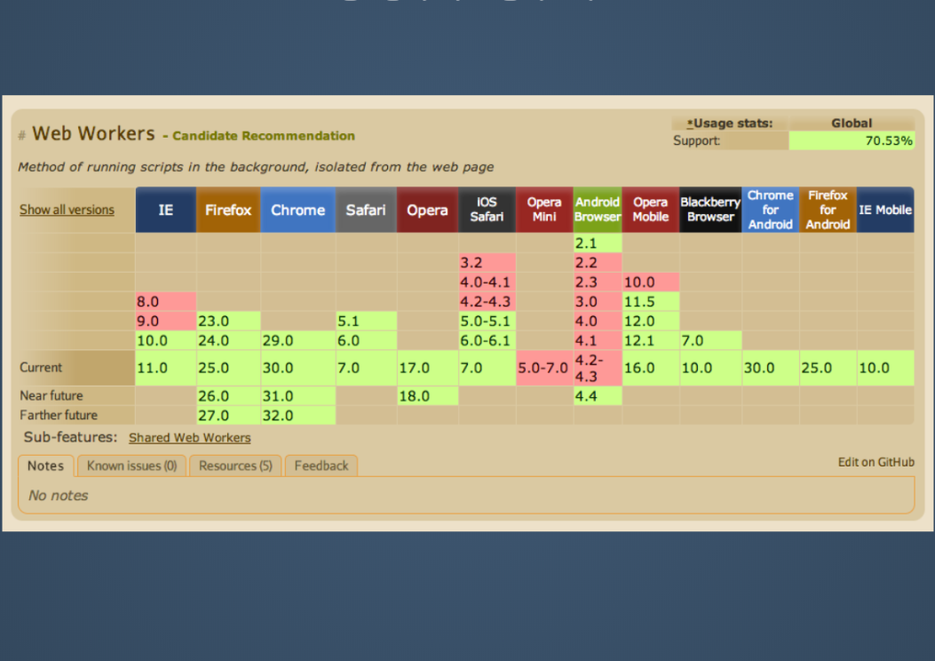
SUPPORT

Slide 15
